Slide 1



IoT & The Cloud
Faculty Workshop
March 28, 2024

Slide 2

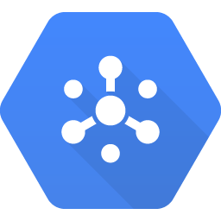




IoT & The Cloud
AGENDA
Welcome & Intros
Goals for the Day
IoT Overview
Raspberry Pi Hardware Setup
Google Cloud Platform (GCP) Ingesting Telemetry Data
Storing the Data
Alerting & Reporting on the Data
Futures
IoT Topic Cloud Pub/Sub
Storage BigQuery
Alert App Integration
Analysis Looker Studio
DOWNLOAD THE SLIDES HERE TO FOLLOW ALONG:
http://tinyurl.com/48khunrk

Slide 3

Logistics Discussion
Everyone on the same page?
Help each other out!
CHECKPOINT

Slide 4

Links exist throughout the deck to dive more deeply into some of the topics we cover
Great for followup after the workshop!

Slide 5
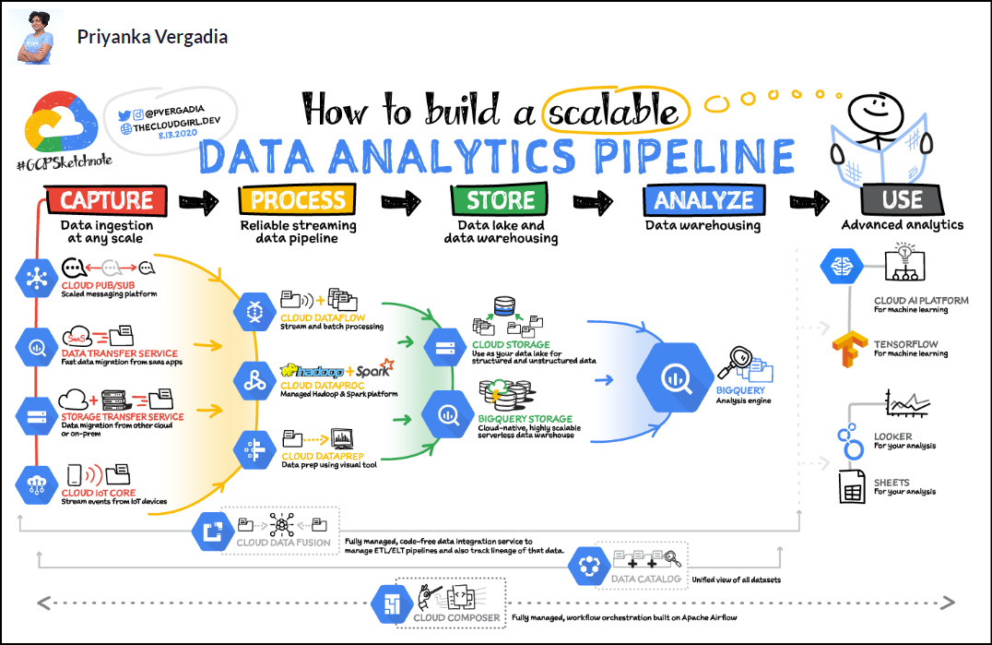

Slide 6






IoT
RPI
GCP
Internet of Things Overview
Number of humans? – 8.1B
Number of cell phones? – 7B
Number of IoT devices? – 24.4 B
Challenges:
Updating & Managing Devices
Managing Telemetry
Managing Data
Examples
Consumer – locks, doorbells, lightbulbs, cars
Commercial – healthcare, monitoring, security
Industrial – digital control sys, agribiz
Infrastructure – smart cities
Internet of Things

Slide 7

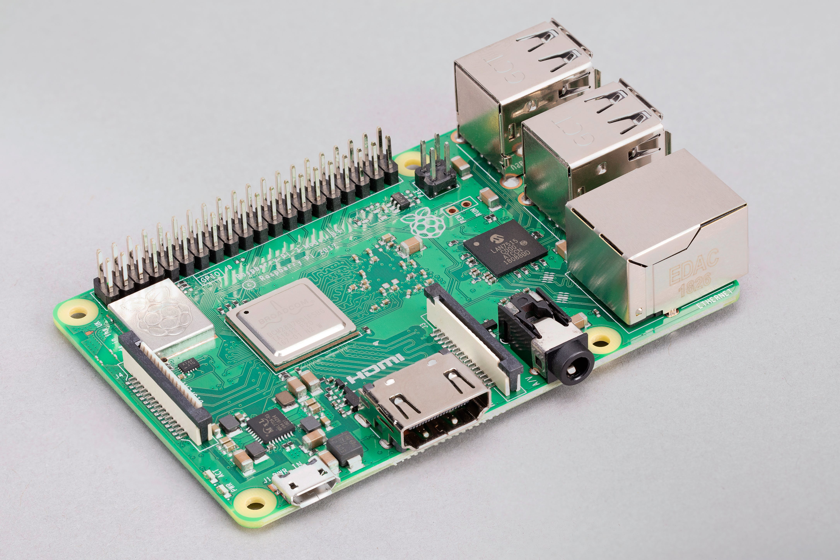

IoT
RPI
GCP
Raspberry Pi Overview
Pi 3 Model B (circa 2016)
Single Board Computer (SBC)
1.2 GHz 64-bit quad core ARM Cortex-A53 processor
1 GB RAM
HDMI output
802.11n Wi-Fi & Bluetooth
8G SD card w/64-bit Debian (bookworm)
GPIO – General Purpose I/O
History of Raspberry Pi
Raspberry Pi Model Comparison

Slide 8
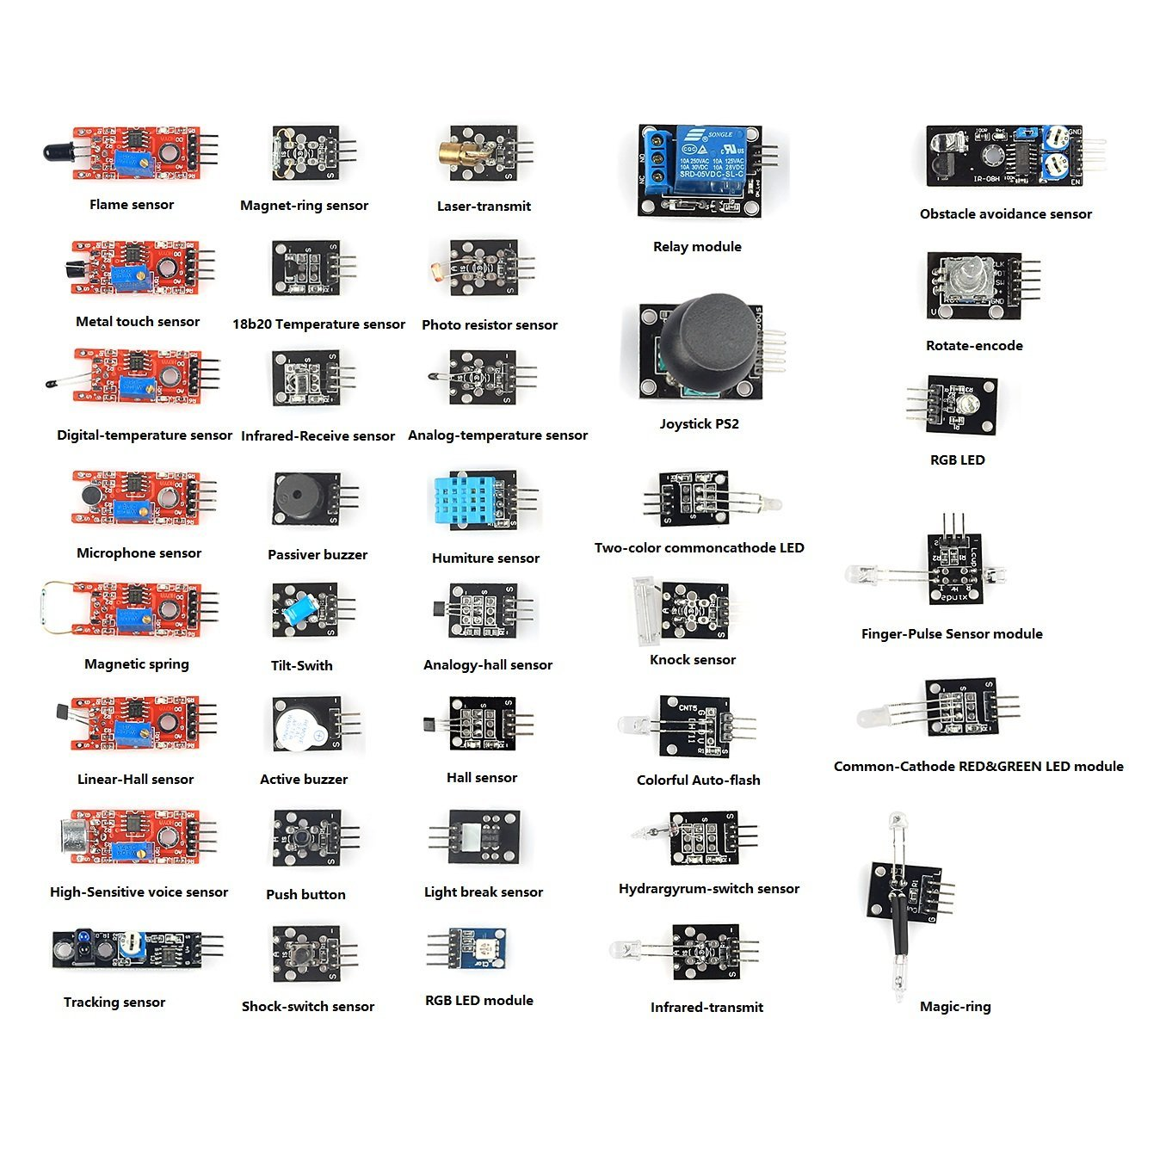
IoT
RPI
GCP
Raspberry Pi Overview
Many popular IoT type sensors can be connected to GPIO:
Temp
Humidity
Light
Fire
Sound
Motion
IR
Joystick, etc.

Slide 9
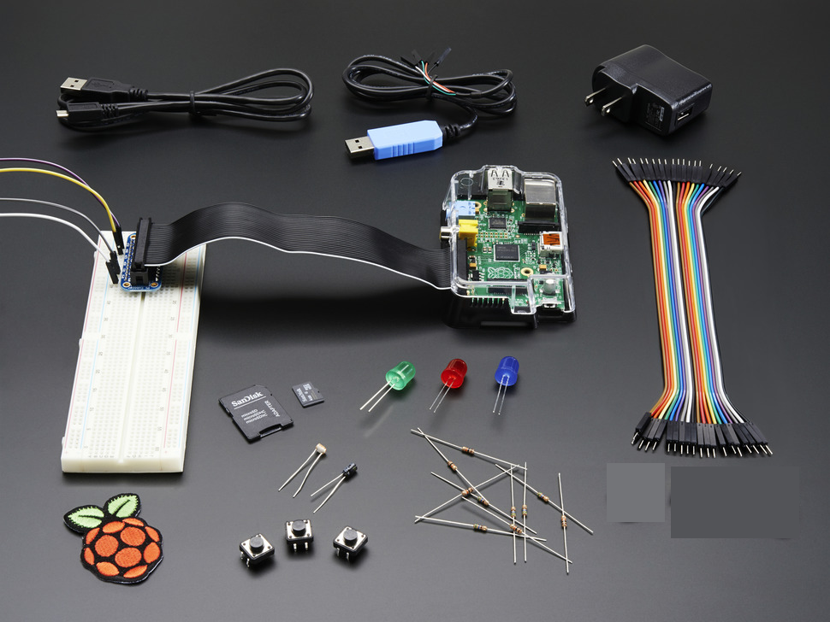
IoT
RPI
GCP
Raspberry Pi Setup
Raspberry Pi 3 Model B
SD Card with Raspbian OS
Pi Case
5v Power Supply
Breadboard and Jumper wires
Leds & Resistors
GPIO breakout ribbon cable
USB jumper (not used)
Raspberry Pi patch
DS18B20 Temp Sensor
What’s in the box??

Slide 10
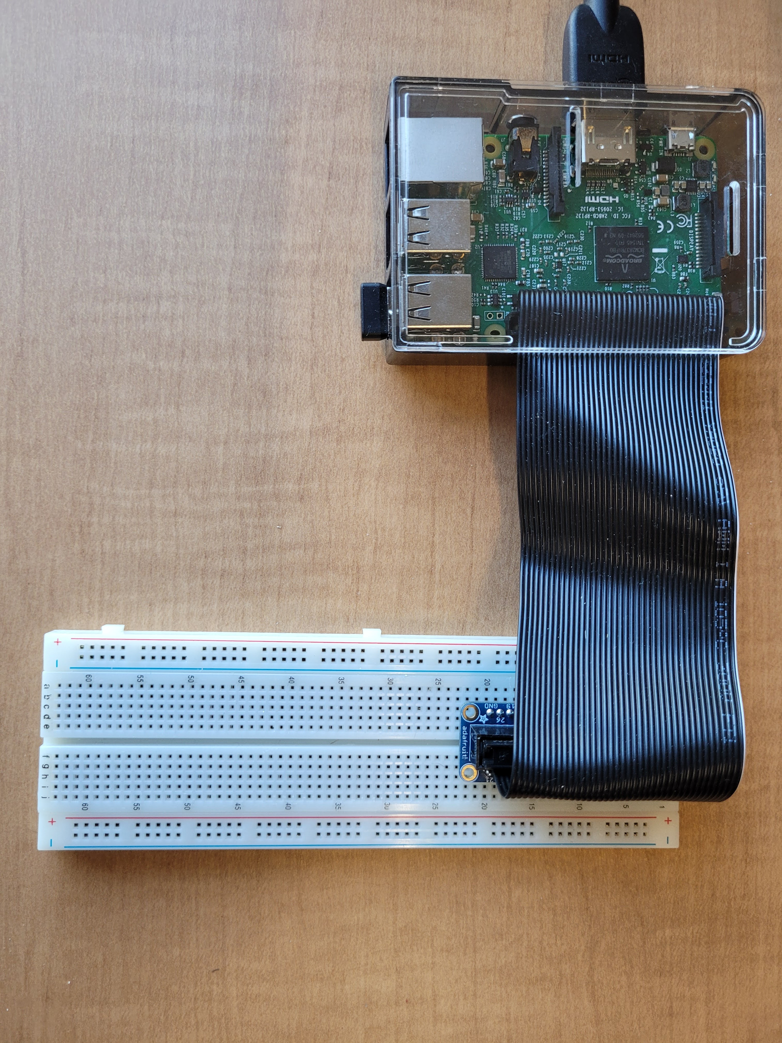
IoT
RPI
GCP
Raspberry Pi Setup
Cable it up:
Insert pi board into case
Insert SD Card
Connect HDMI monitor
Connect Keyboard
Connect Mouse
Cable GPIO to Breadboard
5v Power supply (do this last!)
Orient the pi breakout board with the “Pi Cobbler” text at the top and plugged in to columns c & g and rows 1 thru 20 on the breadboard – it will be tight when you plug it in the first time, and you may have to use some force to get it seated properly.
Orient the ribbon cable with the white stripe at the top – there is a notch on the ribbon connectors that will help you to position it correctly – the notch faces in (left) on pi side and fits into a slot on the left side of the pi breakout board.

Slide 11
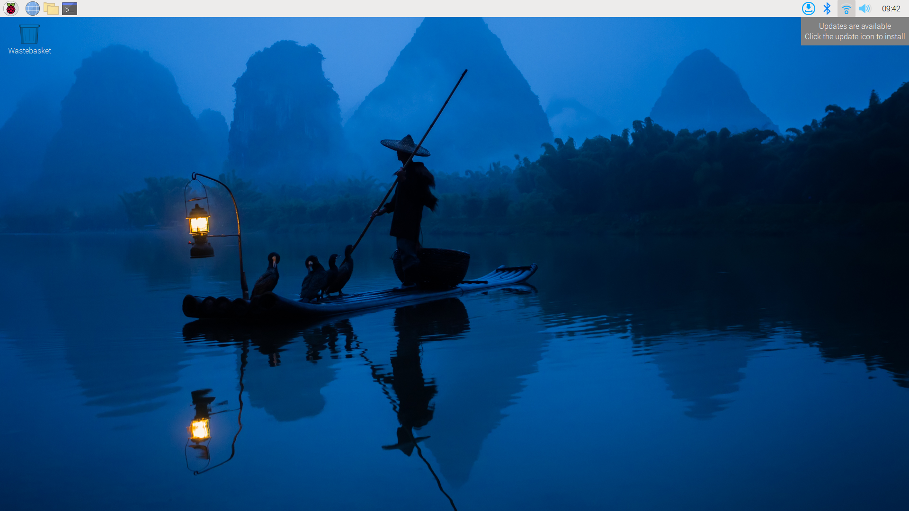
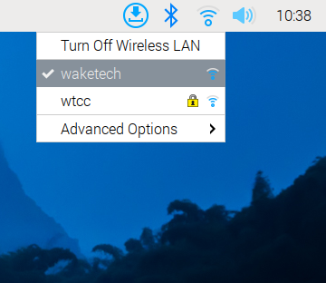
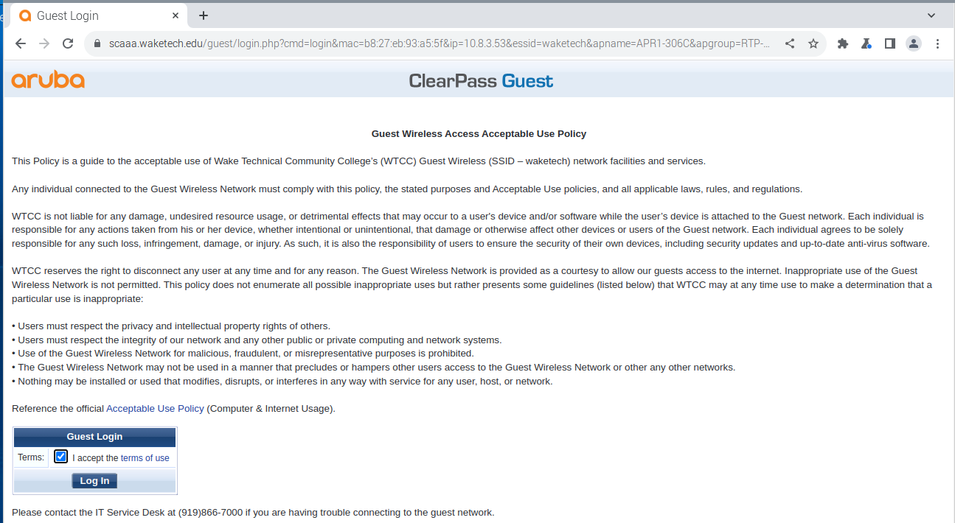
IoT
RPI
GCP
Raspberry Pi Setup
Initial Startup – Be patient – it’s a bit slow!
Check that your machine has joined the wireless network (waketech)
Click the wireless icon in upper right
Launch a web browser by clicking the small globe icon in the upper left of the screen (be patient – it’s slow!)
Accept the Aruba guest logon screen agreement in order to use the wireless connection
1
2
3

Slide 12
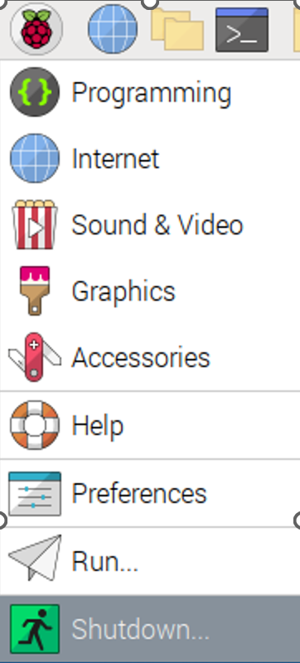
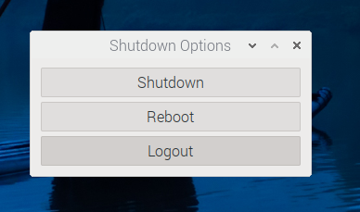
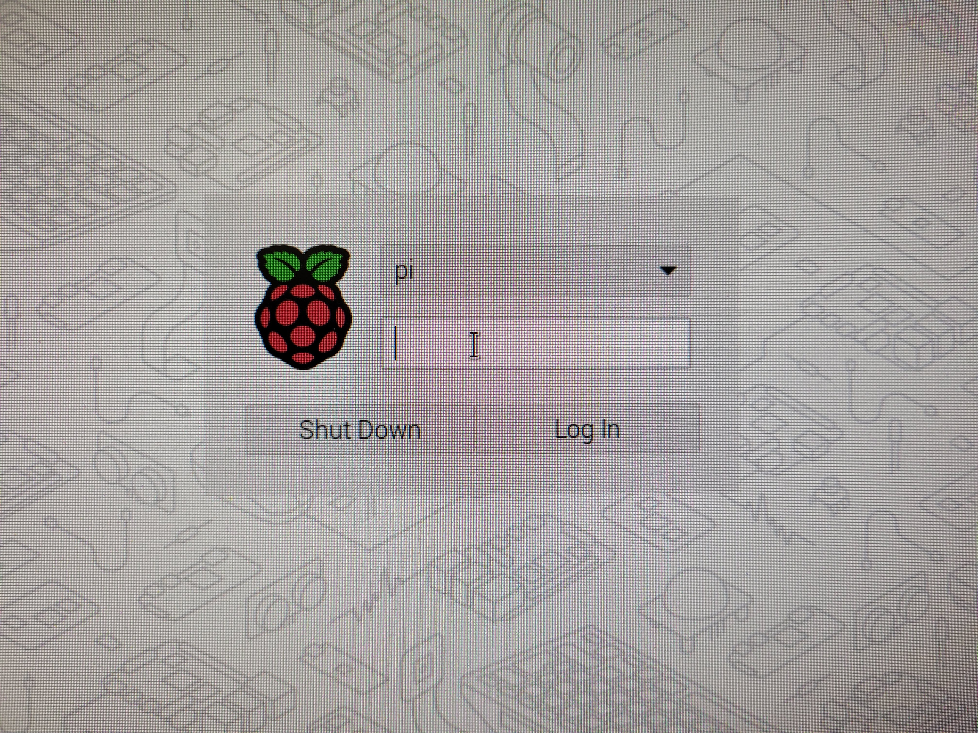
IoT
RPI
GCP
Raspberry Pi Setup
Initial Startup – Be patient – it’s a bit slow!
Test the logoff / logon process
Click the raspberry icon in upper left & select the Shutdown menu choice and select Logout
Log back on with:
username = pi
password = raspberry
1
3
2
4

Slide 13
Raspberry Pi rebooted, connected to the network and showing the desktop
CHECKPOINT

Slide 14
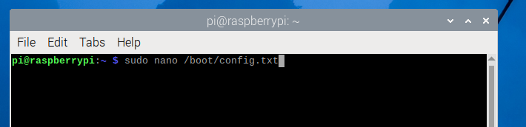
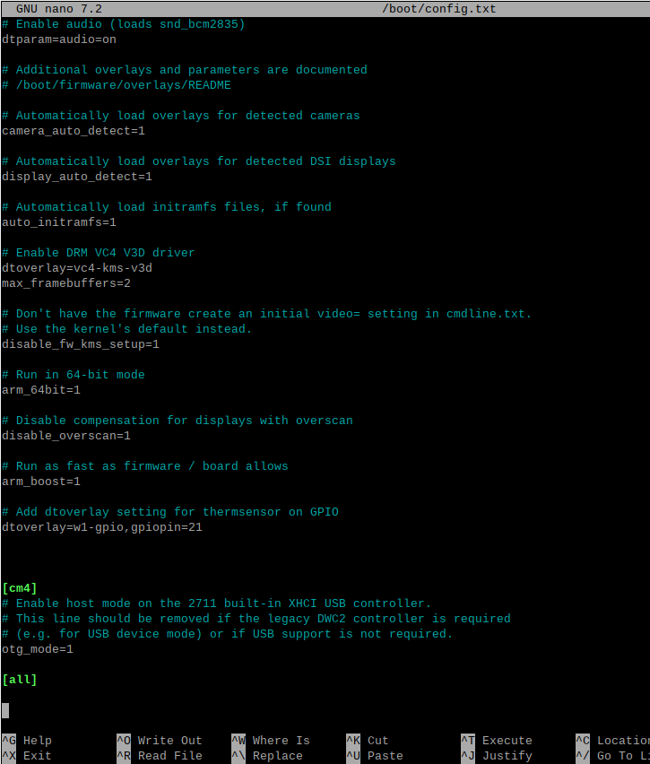
IoT
RPI
GCP
Raspberry Pi Setup
Config tweak needed for our project:
Launch terminal and run this command
sudo nano /boot/config.txt
Then add these 2 lines at the bottom just before the [cm4] section:
# Add dtoveraly setting for thermsensor on GPIO
dtoverlay=w1-gpio,gpiopin=21
Type CTRL+O to write then CTRL+X to exit
Then reboot (pi menu – choose Shutdown)

Slide 15
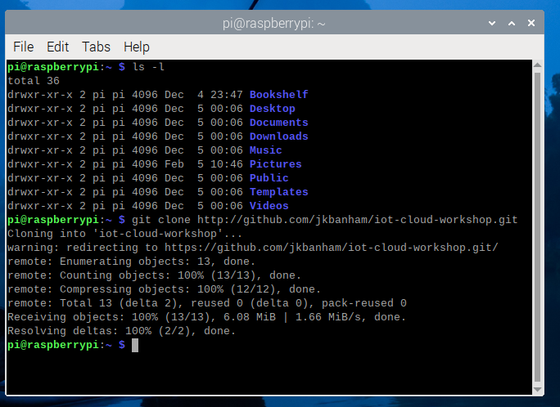
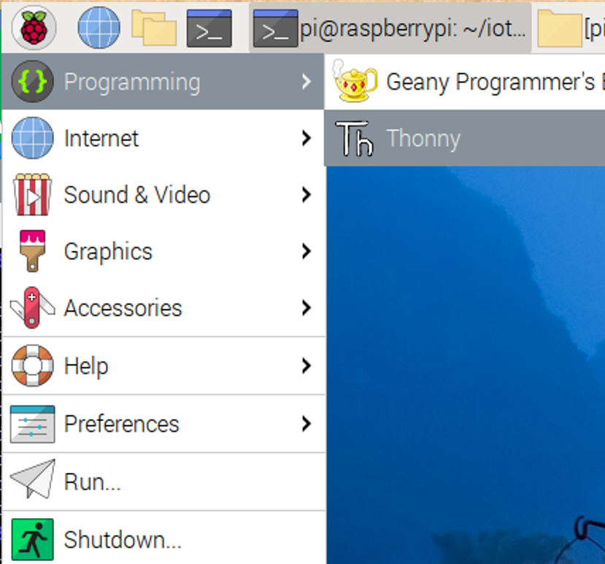
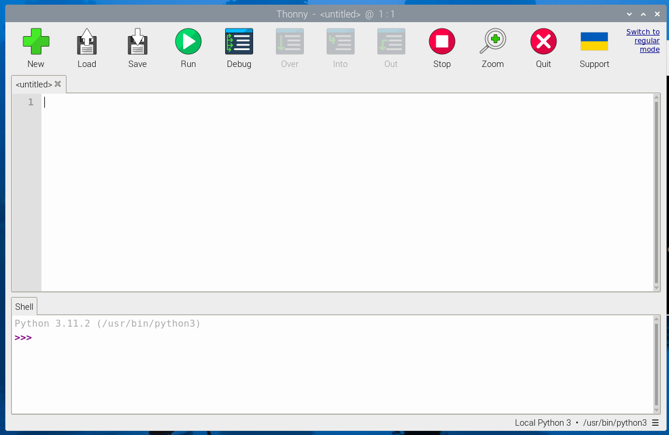
IoT
RPI
GCP
Raspberry Pi Code
Launch terminal and run this command:
git clone http://github.com/jkbanham/iot-cloud-workshop.git
Note that you should now have a new directory with files we use for this project:
/home/pi/iot-cloud-workshop/
Launch the Thonny IDE from the Pi menu under Programming. Click on the ‘Switch to regular mode’ link in the upper right
Close Thonny and then re-launch it
1
2
3

Slide 16
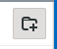
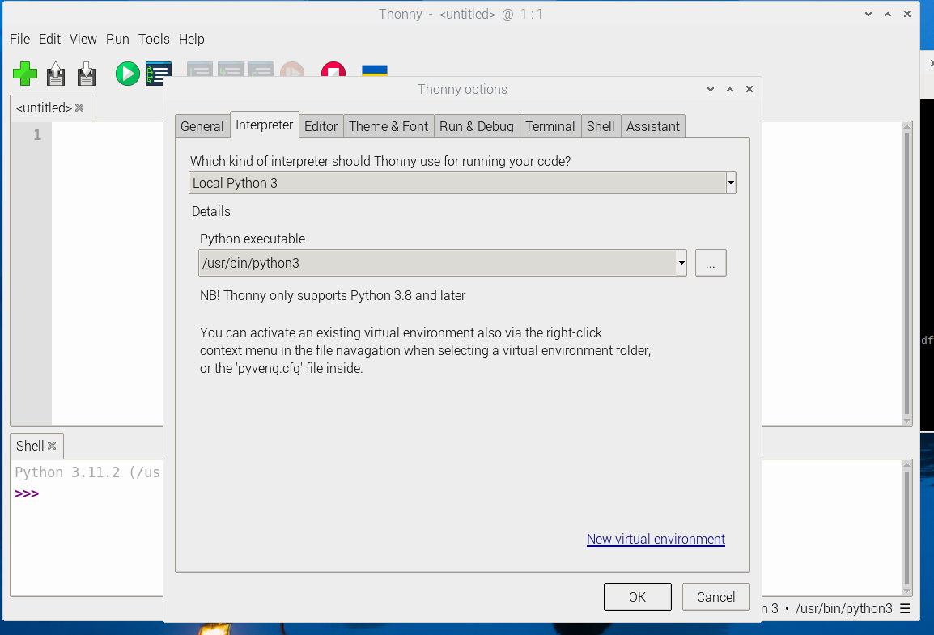
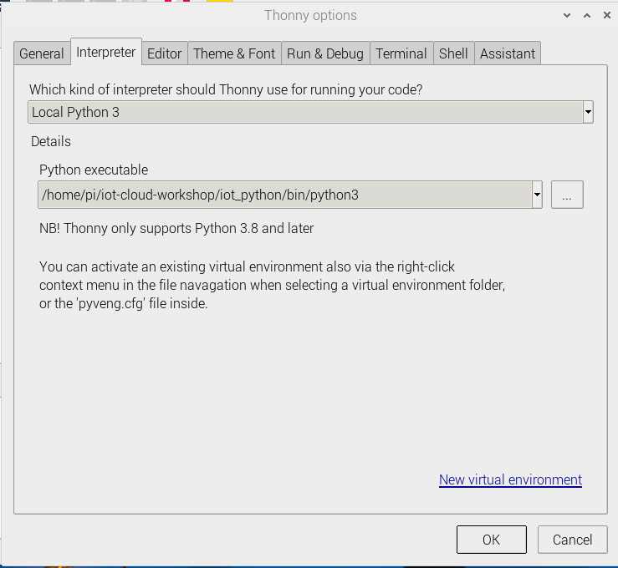
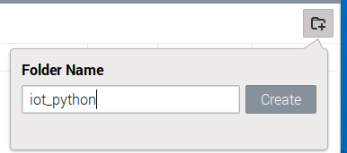
IoT
RPI
GCP
Raspberry Pi Code
From the ‘Run’ menu, select ‘Configure Interpreter’ and then click the ‘New virtual environment’ link in the lower right
In the dialog box to “Select empty directory for new virtual environment”, browse to the /home/pi/iot-cloud-workshop folder and click the ‘Create Folder icon in the upper right. Type iot_python and click ‘Create’.
Click ‘OK’ at the bottom and the new virtual python environment will be created.
1
2
3
4
5

Slide 17
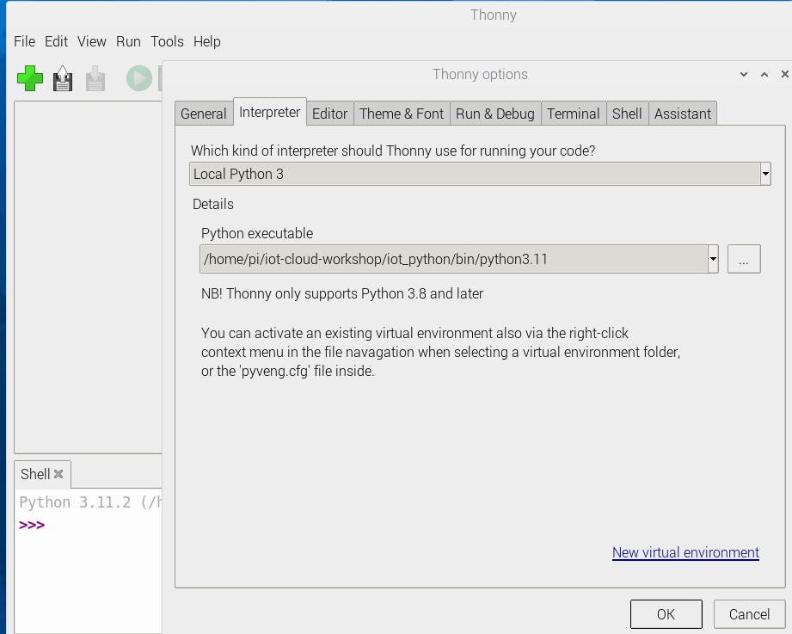
IoT
RPI
GCP
Raspberry Pi Code
Set the new virtual environment as the default interpreter in the Thonny IDE application:
Open the Tools -> Options menu and select the Interpreter tab
Select the python version 3.11 executable file from the new virtual environment that you created (/home/pi/iot-cloud-workshop/iot_python/bin/python3.11)
Click OK to save
1
2
3
4

Slide 18
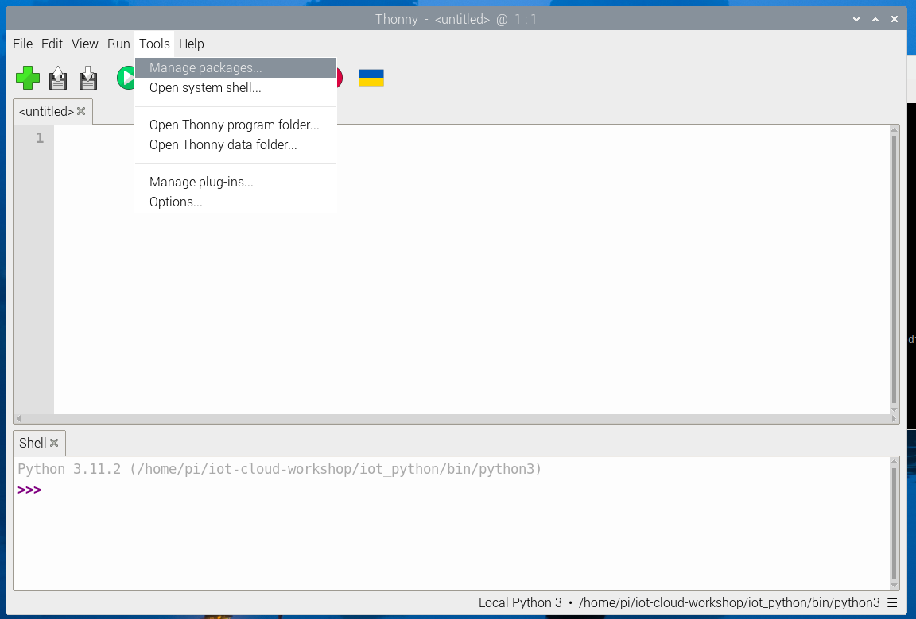
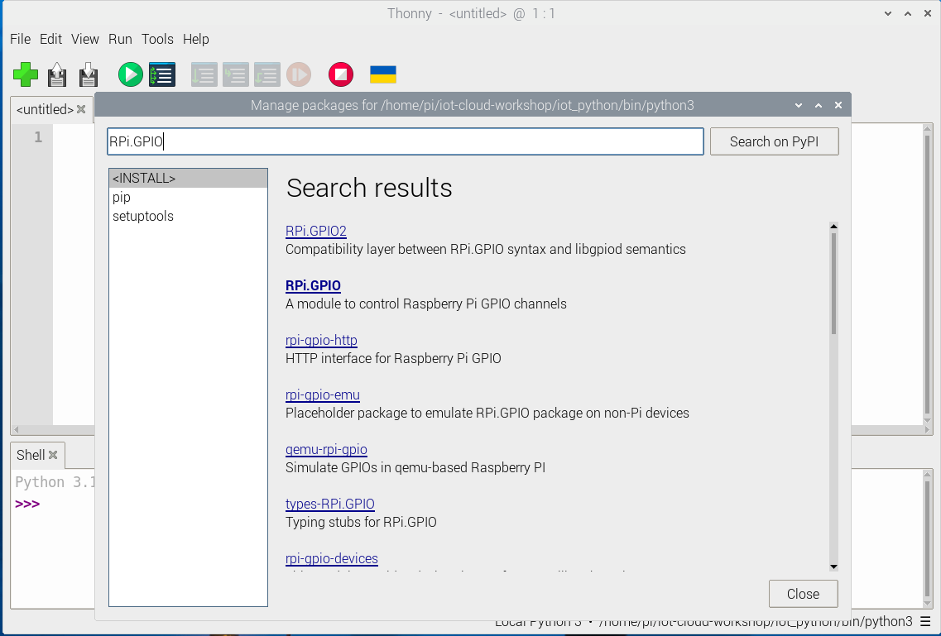
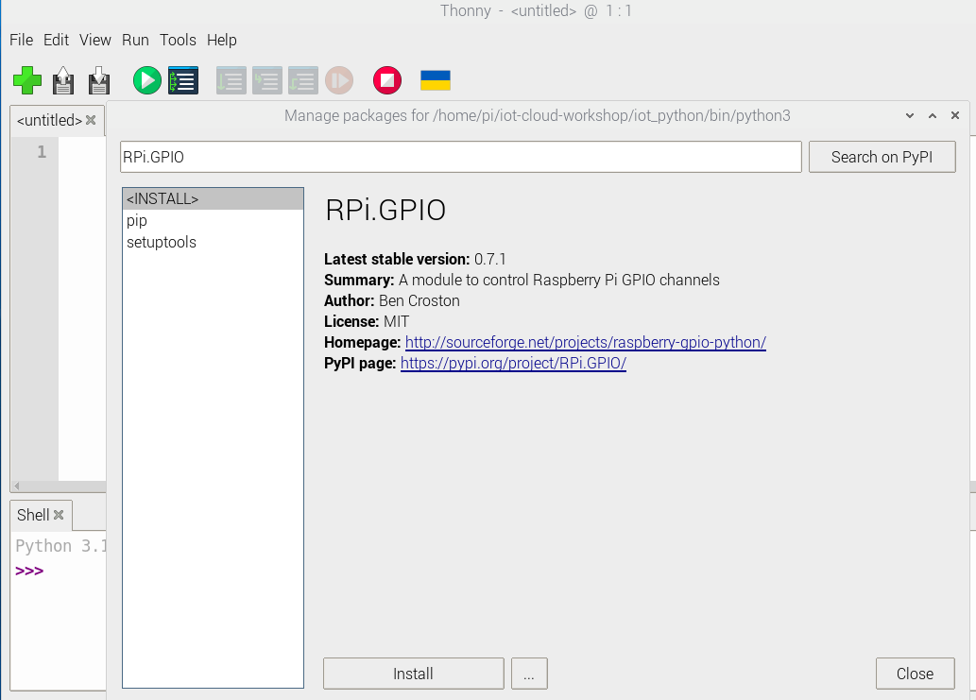
IoT
RPI
GCP
Raspberry Pi Code
Open the Tools -> Manage Packages menu
Type RPi.GPIO (note lowercase ‘i’) in the ‘Search on PyPI’ box and then click the module when it appears and then click Install button in lower left
Repeat the same process described above for the W1thermsensor module and the google-cloud-pubsub module
1
2
3

Slide 19
Git repo cloned, Thonny launched, Python virtual environment created, Python modules installed
Check & Compare with Instructor’s Screen View
CHECKPOINT

Slide 20
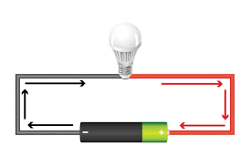
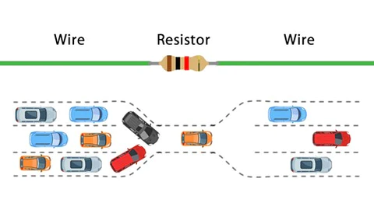
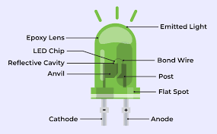
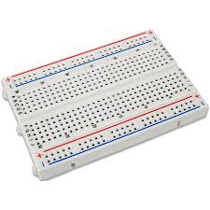
IoT
RPI
GCP
Raspberry Pi Sensor
Some key concepts:
Voltage
Polarity
Resistors
LEDs
Breadboard
More info about circuits

Slide 21
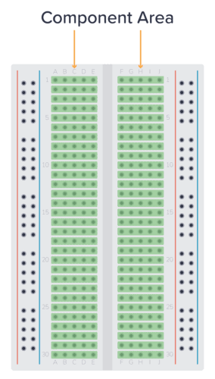
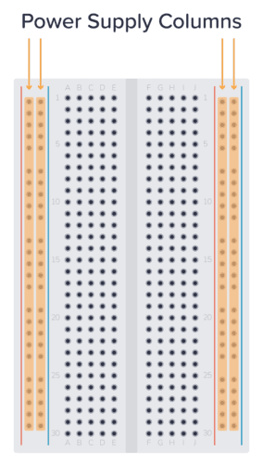
IoT
RPI
GCP
Raspberry Pi Sensor
What is a breadboard?
Used for easy electronic circuit prototyping – no soldering required
The story is that a vacuum tube engineer drove nails into his kitchen bread cutting board and connected them with wires
Power supply columns are common (red/pos & blue/neg) Numbered rows in component area are common (on each side only – no commonality across middle gap)
More info about breadboards

Slide 22
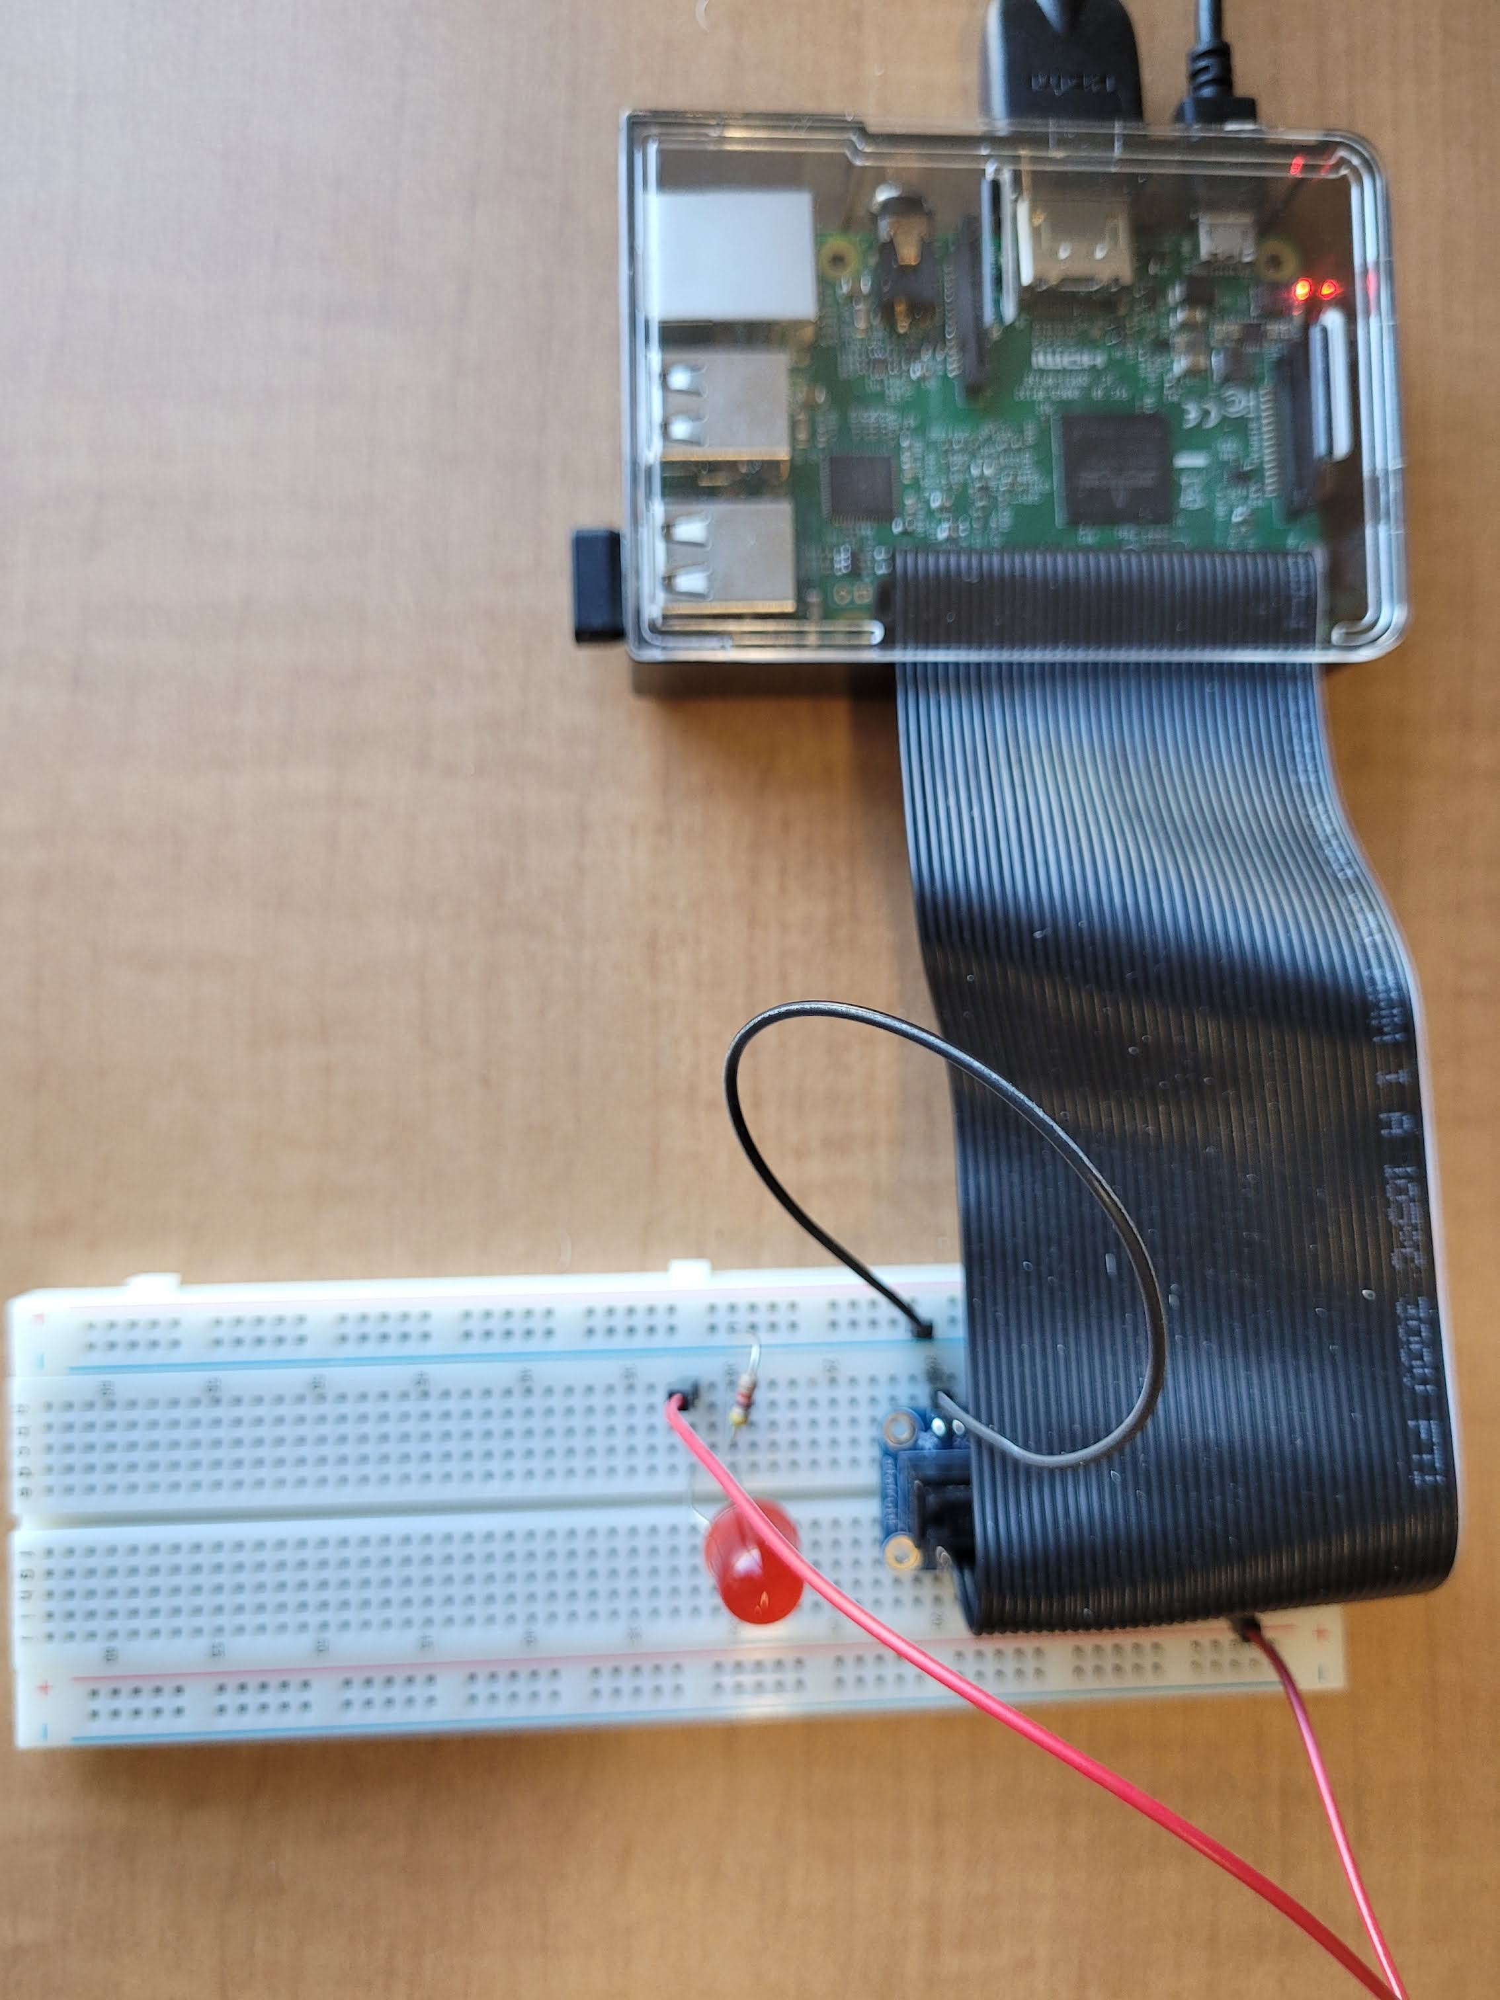
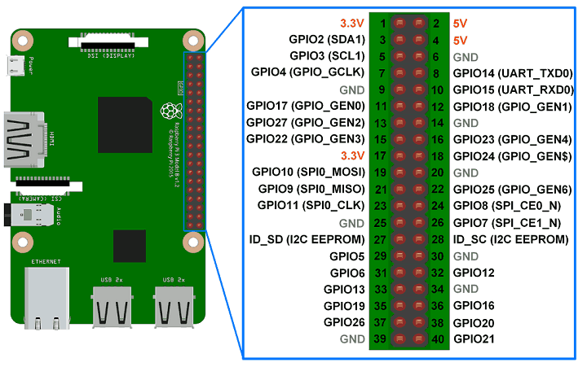
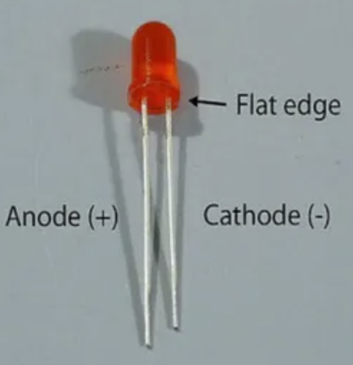



IoT
RPI
GCP
Raspberry Pi Sensor
Make the following connections on your breadboard:
Plug the red LED into the breadboard with the short leg (cathode (-)) in row 30 column c and the long leg (anode (+)) in row 32 column c
Plug a resistor between row 30 column a and the negative (blue) rail
Plug a jumper wire from pi pin 39 (GND - row 20, col a) to the blue rail
Plug a jumper wire from pi pin 12 (GPIO18 – row 6, col j) on the raspberry pi breakout board to row 32 column a
How does an LED work?
Using GPIO pins with LEDs

Slide 23
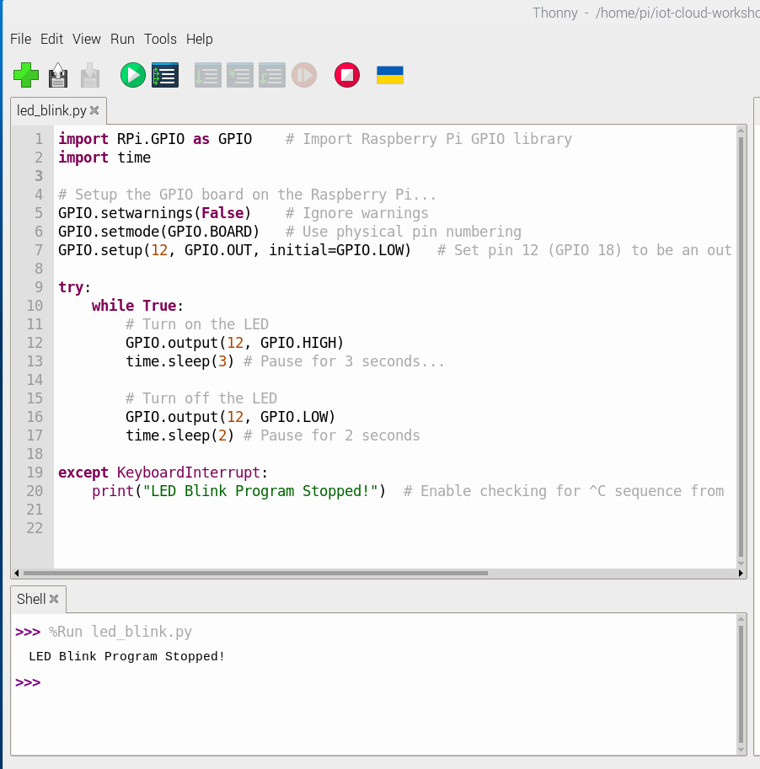

IoT
RPI
GCP
Raspberry Pi Code
In the Thonny IDE, open the file named /home/pi/iot-cloud-workshop/led_blink.py
Read through the code and ask any questions you might have
Click the button and check to see if your LED starts to blink
Press CTRL+C to stop the program
Thonny screenshot – open file

Slide 24
Code runs successfully to blink the LED
CHECKPOINT

Slide 25
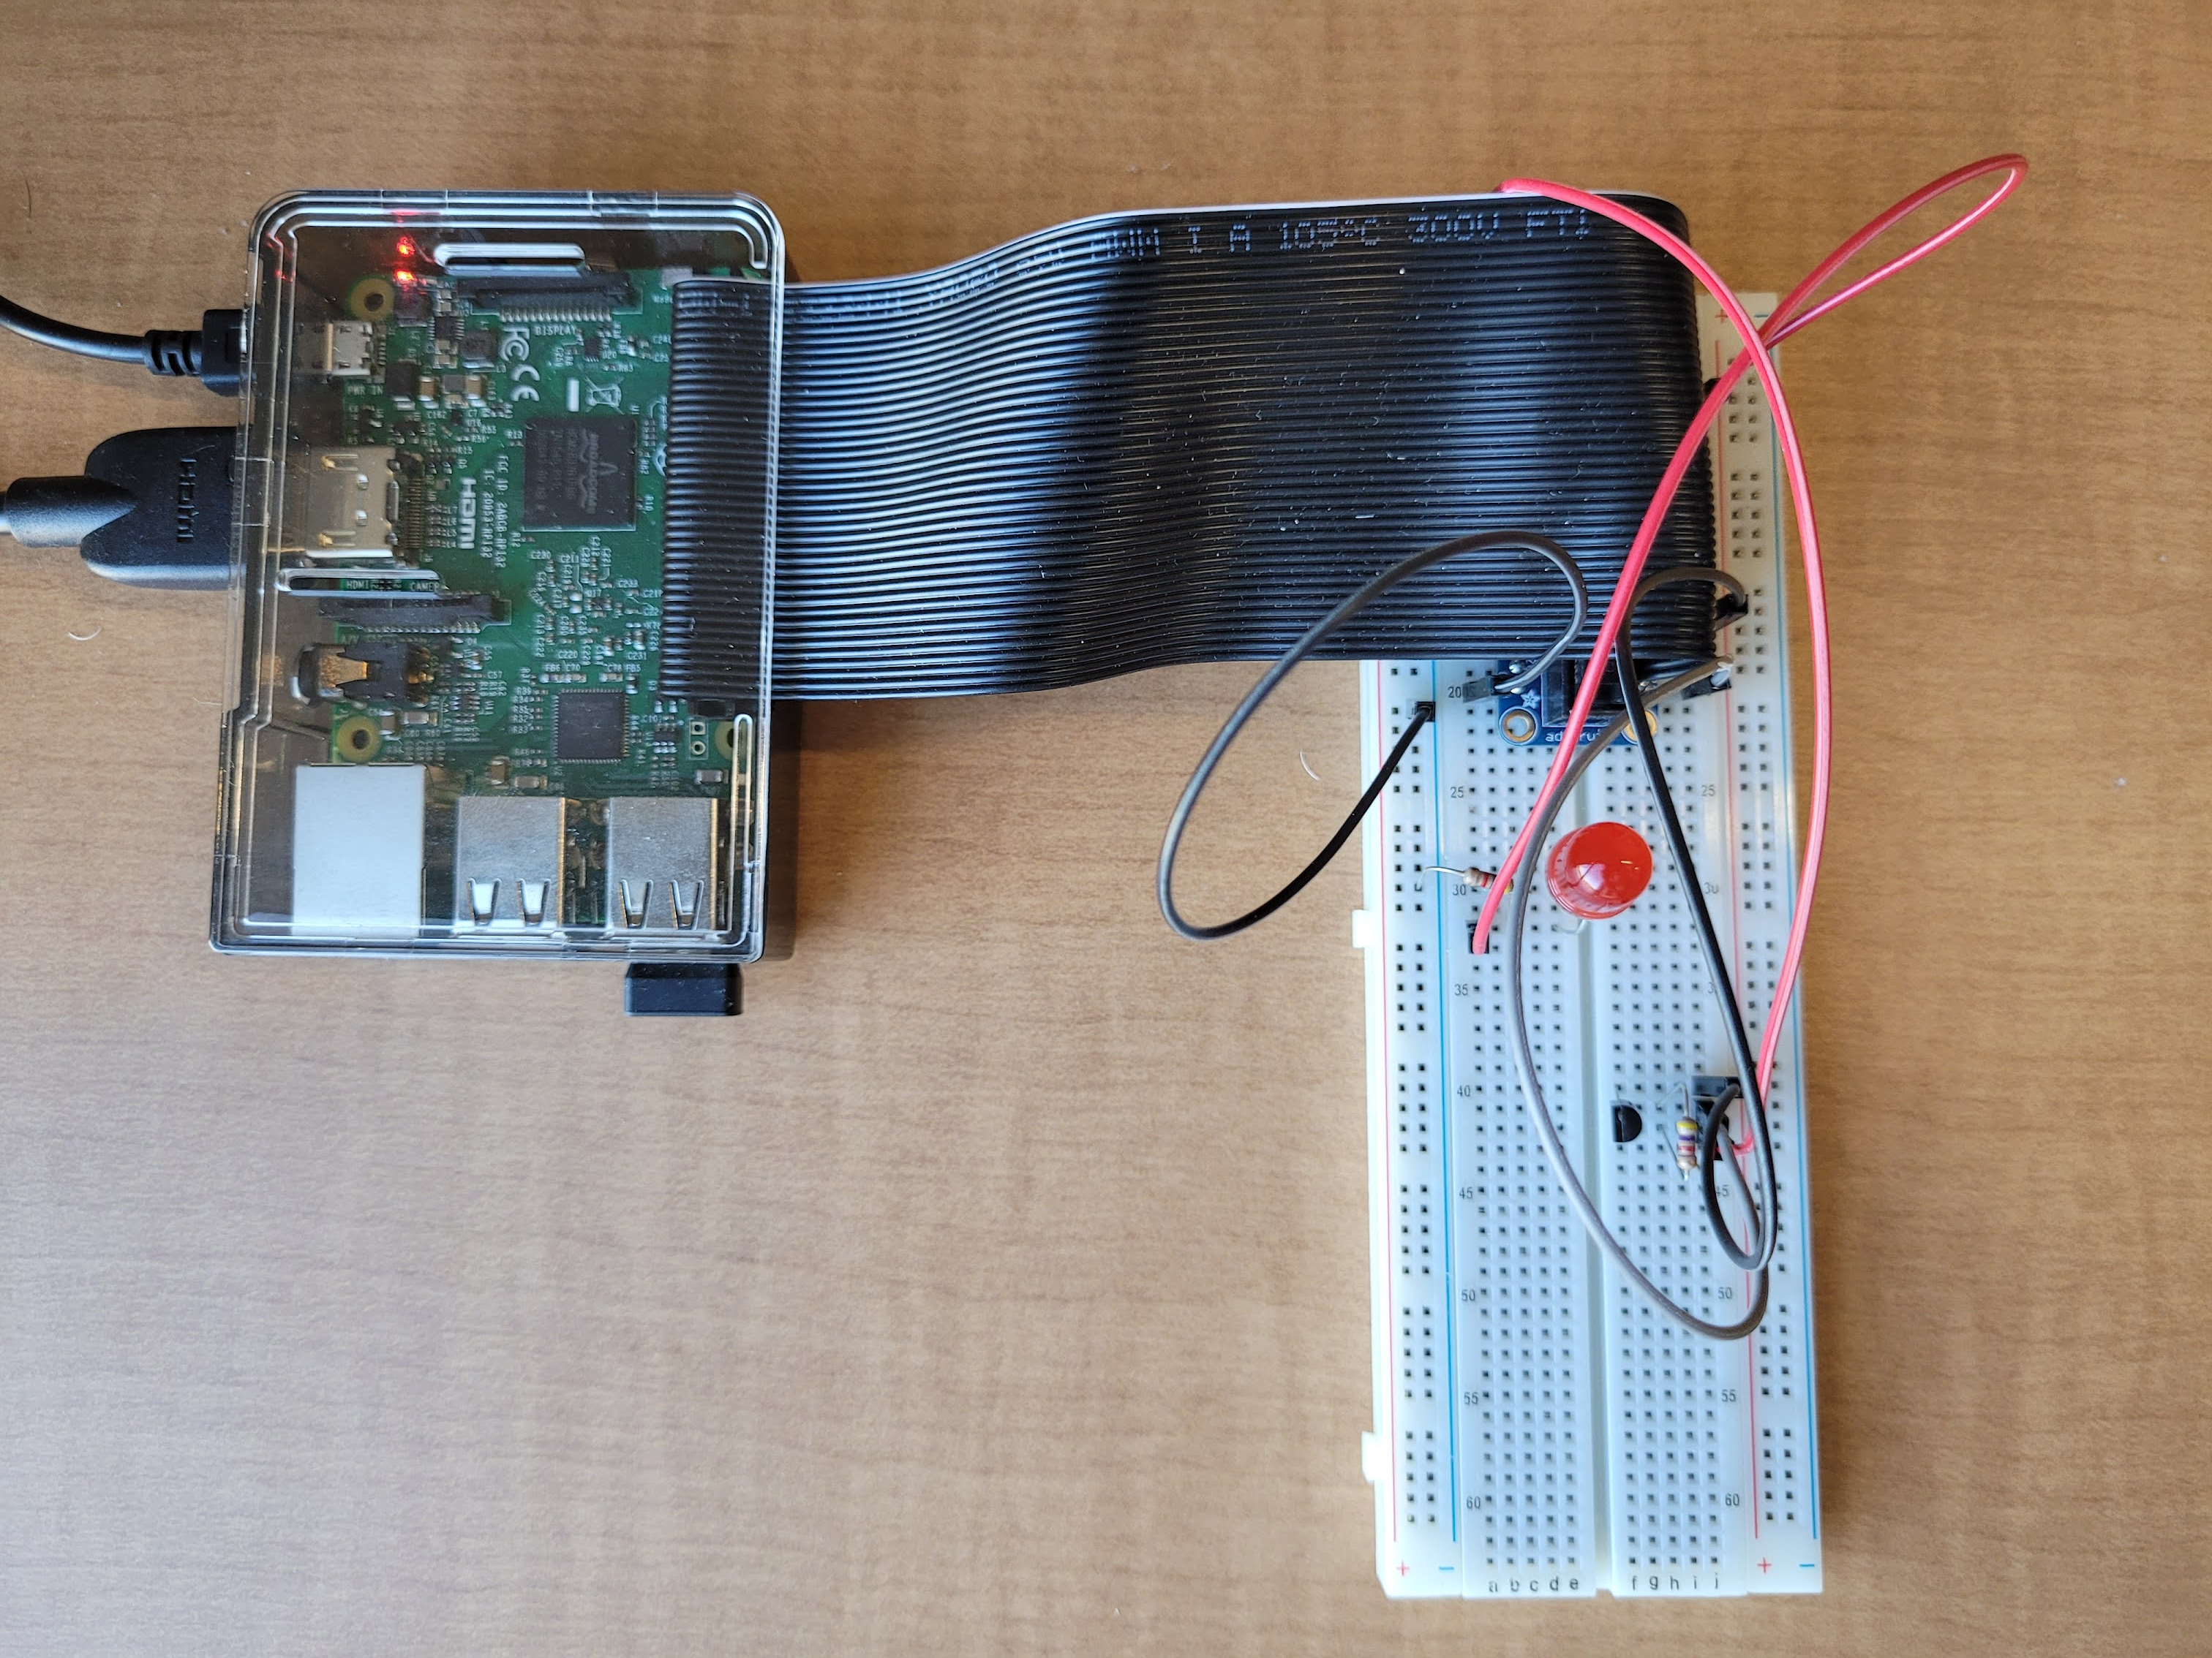
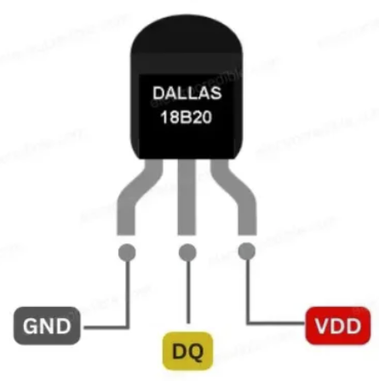
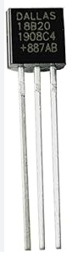



IoT
RPI
GCP
Raspberry Pi Sensor
Make the following connections on your breadboard:
Plug your DS18B20 sensor into the board with pin 1(GND) in row 40 column f, pin 2(DATA) in row 41 column f, and pin 3 (voltage) in row 42 column f on the breadboard
Plug a resistor between rows 41 & 42 in column h
Plug a jumper wire from row 40 col j to pi pin 34 (GND – row 17, col j) on the breadboard
Plug a jumper wire from row 41 col j to pi pin 40 (GPIO21 – row 20, col j) on the breadboard
Plug a jumper wire from row 42 col j to pi pin 1 (3v – row 1, col a) on the breadboard
How does the DS18B20 work?

Slide 26
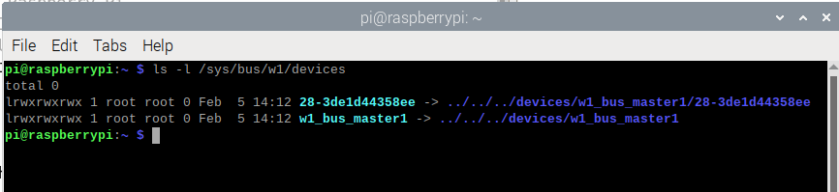
IoT
RPI
GCP
Raspberry Pi Sensor
Open a terminal and type:
ls –l /sys/bus/w1/devices
If you see an output line starting with "28-“ then you have set things up correctly and there is an active temp sensor connected to your Pi! (If you don’t see it then something is wrong and troubleshooting is needed!)
* Note that the DS18B20 will get very hot if it is wired incorrectly (reverse polarity)

Slide 27
Everyone can see the sensor in the /sys/bus/w1/devices folder
CHECKPOINT

Slide 28
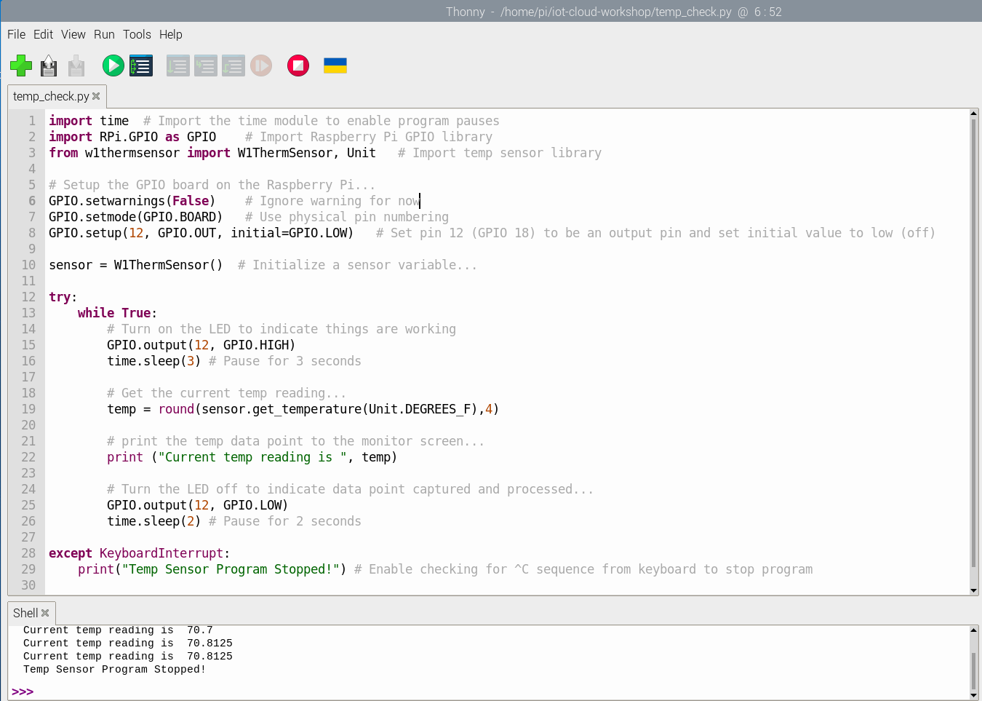
IoT
RPI
GCP
Raspberry Pi Code
In the Thonny IDE, open the file named /home/pi/iot-cloud-workshop/temp_check.py
Read through the code and ask any questions you might have
Click the button and check to see if temp readings print to the program output shell tab
Press CTRL+C to stop the program

Slide 29
Code runs successfully to blink the LED and print the temp reading to the screen
Test putting your fingers on the temp sensor to watch the readings change
CHECKPOINT

Slide 30

LUNCH BREAK

Slide 31

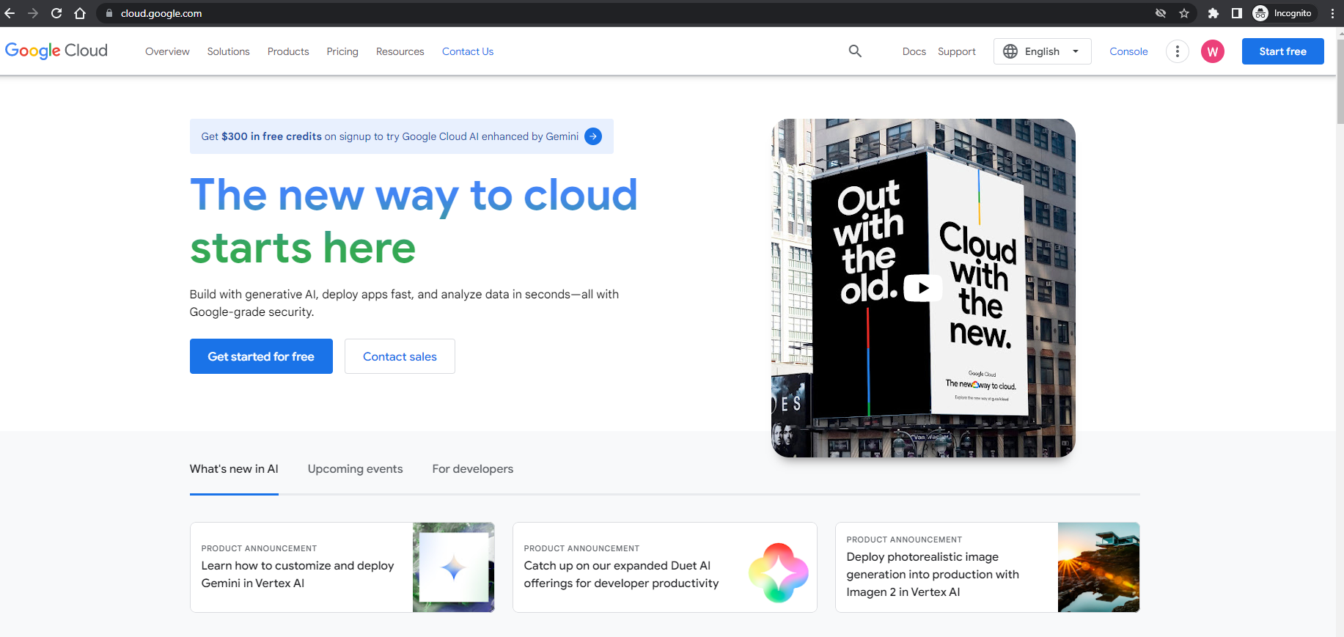
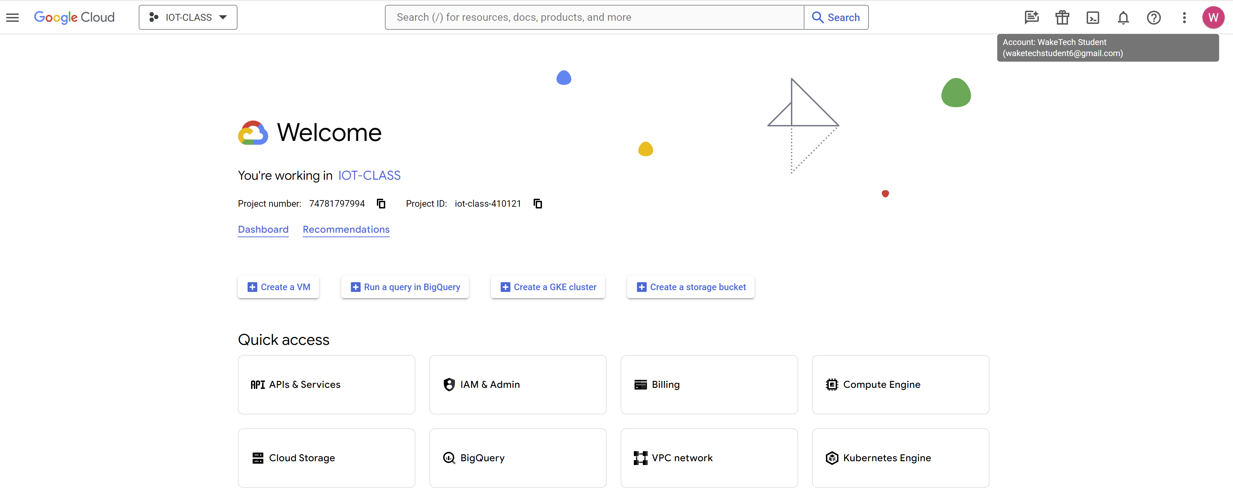
IoT
RPI
GCP
Google Cloud Platform (GCP)
STEP 1: Create a GCP Account
This step was completed prior to the workshop - confirm that you can log in to console.cloud.google.com in a browser window

Slide 32
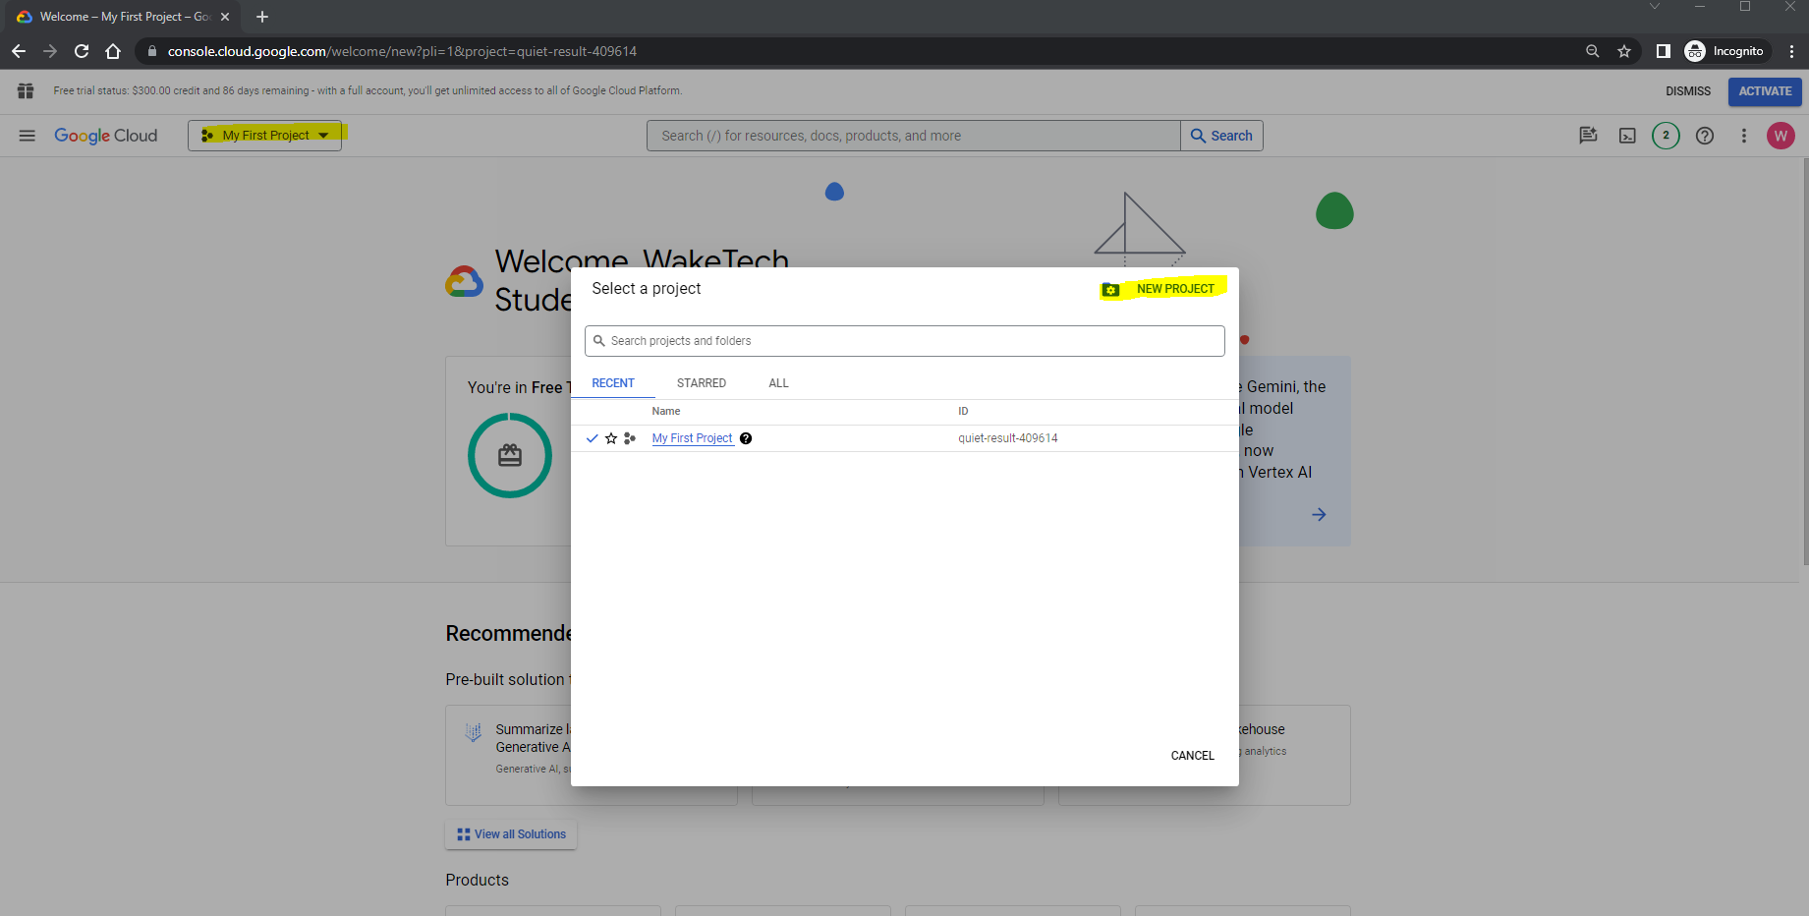

IoT
RPI
GCP
Google Cloud Platform (GCP)
STEP 2: Create a New Project
Once you are logged in to console.cloud.google.com, click on the active project name in the upper left. Then click the button
1
2
Google Cloud Projects

Slide 33
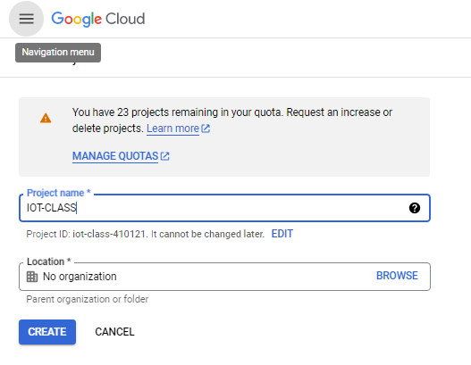
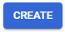
IoT
RPI
GCP
Google Cloud Platform (GCP)
STEP 2: Create a New Project
Name the new project ‘IOT-CLASS’ and then click the button
1
2

Slide 34
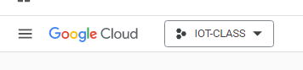
IoT
RPI
GCP
Google Cloud Platform (GCP)
STEP 2: Create a New Project
Click the project list in upper left again and then select the new IOT-CLASS project – it should now show as your active project while you are working in the GCP console

Slide 35
Everyone has a new project created named IOT-CLASS
CHECKPOINT

Slide 36
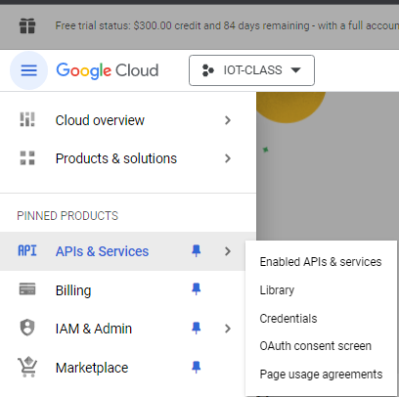
IoT
RPI
GCP
Google Cloud Platform (GCP)
STEP 3: Enable APIs
From the navigation menu on the left-hand side (often referred to as the ‘hamburger’ menu), select APIs & Services | Library
1
2
3
What is an API

Slide 37
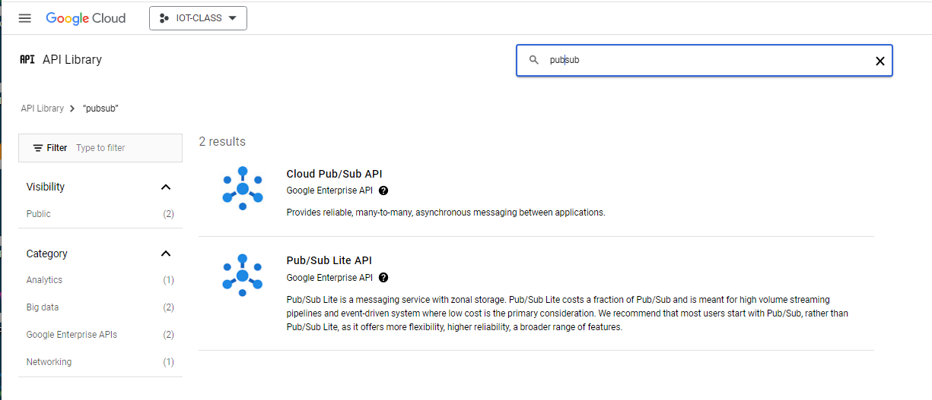
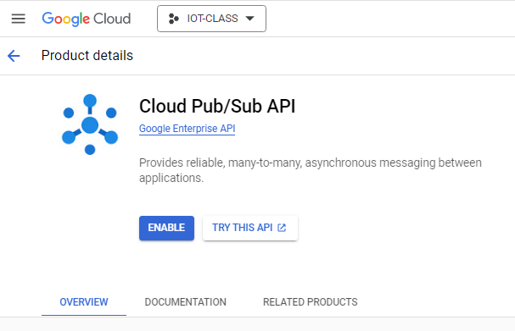
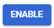
IoT
RPI
GCP
Google Cloud Platform (GCP)
STEP 3: Enable APIs
On the next screen, type ‘pubsub’ in the search box and then click the Cloud Pub/Sub API from the results
On the next screen, click the button
Repeat this same process to enable the Application Integration API
1
2
3

Slide 38

IoT
RPI
GCP
Google Cloud Platform (GCP)
STEP 4: Create a Service Account
From the navigation menu on the left-hand side, select IAM & Admin | Service Accounts
1
2
3
What is a Google Service Account

Slide 39


IoT
RPI
GCP
Google Cloud Platform (GCP)
STEP 4: Create a Service Account
On the next screen, click the button near the top left of the screen

Slide 40


IoT
RPI
GCP
Google Cloud Platform (GCP)
STEP 4: Create a Service Account
Give the new service account a name of “IOT-PROJECT” and then click
1
2

Slide 41




IoT
RPI
GCP
Google Cloud Platform (GCP)
STEP 4: Create a Service Account
In the ‘Select a role’ drop-down list, scroll down and select the ‘Pub/Sub Admin’ role
Repeat this process to also add the ‘BigQuery Data Editor’ role
Click and then the button at the bottom.
1
3
2
4
5

Slide 42
Everyone has a new service account named IOT-PROJECT created and has granted it roles for Pub/Sub & BigQuery
CHECKPOINT

Slide 43



IoT
RPI
GCP
Google Cloud Platform (GCP)
STEP 5: GET API CREDENTIALS
While on the service accounts page, Click your newly created service account to open it’s details page:
On the Service Account details page, click the ‘KEYS’ tab, and then click the button, and select the ‘Create new key’ option.
1
2
3
4

Slide 44



IoT
RPI
GCP
Google Cloud Platform (GCP)
STEP 5: GET API CREDENTIALS
Select JSON for the key type and then click the button
A new public/private key pair is generated and the private key file is downloaded to your computer. Save it to a USB thumb drive with the name credentials.json
Swap your thumb drive over to the pi and copy the file to:
/home/pi/iot-cloud-workshop/credentials.json
1
2
4
What is a JSON file

Slide 45
Everyone has the credentials.json file saved locally in the iot-cloud-workshop folder on their Raspberry Pi
CHECKPOINT

Slide 46


IoT
RPI
GCP
Google Cloud Platform (GCP)
Storage BigQuery
1
3
STEP 6: BIGQUERY TABLE
From the service navigation menu, choose BigQuery | BigQuery Studio – click the 3 dots to the left of your project name in the explorer pane and select ‘Create dataset’
2
4
5
Google BigQuery

Slide 47


IoT
RPI
GCP
Google Cloud Platform (GCP)
Storage BigQuery
STEP 6: BIGQUERY TABLE
Type ‘RPITempSensor’ in the Dataset ID field and click the button at the bottom
1
2

Slide 48

IoT
RPI
GCP
Google Cloud Platform (GCP)
STEP 6: BIGQUERY TABLE
You’ll see the new data set appear at the bottom of your BQ Explorer window – click the 3 dots to the right of the dataset name and select ‘Create table’
1
2

Slide 49


IoT
RPI
GCP
Google Cloud Platform (GCP)
Storage BigQuery
STEP 6: BIGQUERY TABLE
In the ‘Create table’ window, set the Table name to TEMP and then click the plus sign under the Schema section to add fields. Add the following fields:
time – type=TIMESTAMP
temp – type=FLOAT
Then click the button at the bottom
1
2
3

Slide 50

IoT
RPI
GCP
Google Cloud Platform (GCP)
Storage BigQuery
STEP 6: BIGQUERY TABLE
You should now see the new table at the bottom of your BQ Explorer window.

Slide 51
Everyone has a new BigQuery dataset and table created
CHECKPOINT

Slide 52


IoT
RPI
GCP
Google Cloud Platform (GCP)
Cloud Pub/Sub
1
STEP 7: CREATE PUB/SUB TOPIC
From the navigation menu on the left-hand side, expand the ‘More Products’ section and scroll down to ‘ANALYTICS’ and then select Pub/Sub | Topics as shown (or you can just type pub/sub in the top search menu and select the Pub/Sub product)
2
3
4
TIP: Click the pin icon next to a service name in the nav menu to keep it ‘pinned’ to the top section of your menu

Slide 53


IoT
RPI
GCP
Google Cloud Platform (GCP)
IoT Topic Cloud Pub/Sub
STEP 7: CREATE PUB/SUB TOPIC
We’ll now create a new Pub/Sub Topic which will be used to collect the telemetry data coming in from the temp sensors.
Click the button

Slide 54


IoT
RPI
GCP
Google Cloud Platform (GCP)
IoT Topic Cloud Pub/Sub
STEP 7: CREATE PUB/SUB TOPIC
Type ‘iot-sensor’ for the Topic ID
Click the check box
Click in the ‘Select a Pub/Sub schema filter box and select
1
2
3
More about Pub/Sub

Slide 55





IoT
RPI
GCP
Google Cloud Platform (GCP)
Cloud Pub/Sub
STEP 7: CREATE PUB/SUB TOPIC
A new ‘Create Schema’ browser tab will open.
Type ‘iot-sensor’ in the Schema ID field
Edit the Schema definition to match the screenshot
Click the button at the bottom left
Make sure you see
Click
1
2
3
5
4
6

Slide 56

IoT
RPI
GCP
Google Cloud Platform (GCP)
Cloud Pub/Sub
STEP 7: CREATE PUB/SUB TOPIC
Now switch back to the ‘Pub/Sub ‘Create Topic’ browser tab
Click the link in the Schema filter and you should see the new schema in the list
Select the newly created schema
Click the button at the bottom left
2
1
3

Slide 57

IoT
RPI
GCP
Google Cloud Platform (GCP)
IoT Topic Cloud Pub/Sub
STEP 7: CREATE PUB/SUB TOPIC
You will now see the details screen for the newly created iot-sensor Topic. Click the link in the middle of the page.

Slide 58


IoT
RPI
GCP
Google Cloud Platform (GCP)
STEP 7: CREATE PUB/SUB TOPIC
We’ll now create a Pub/Sub ‘subscription’ to enable real-time ingestion of the IoT temp sensor data into the BigQuery database.
Type ‘IOT-CLASS’ for the Subscription ID
Select ‘Write to BigQuery’ for the Delivery type
Select the Project, Dataset, and Table as shown
Select the ‘Use Topic Schema’ choice for Schema Option
Scroll to the bottom of the page and click the
button (not shown in screenshot)
1
2
3
3
3
4

Slide 59

IoT
RPI
GCP
Raspberry Pi Code
In the Thonny IDE, open the file named
/home/pi/iot-cloud-workshop/sensor_cloud.py
Read through the code and ask questions
Edit the values of the GOOGLE_APPLICATION_CREDENTIALS & project_id variables to match your environment
Click the button and check to see if temp readings print to the screen
Press CTRL+C to stop the program
3
2
1
4

Slide 60




IoT
RPI
GCP
Google Cloud Platform (GCP)
STEP 7: CREATE PUB/SUB TOPIC
Open your iot-sensor Pub/Sub topic and click the tab to ensure messages are being published to the topic
Open BigQuery Studio and verify that data is being collected in your TEMP table via the subscription (click the tab)
1
2
4
3

Slide 61
Everyone has successfully streamed temperature data from the Raspberry Pi into GCP
(Pub/Sub Stats & BigQuery table contents show successful publishing of data)
CHECKPOINT

Slide 62


IoT
RPI
GCP
Google Cloud Platform (GCP)
STEP 8: Alerting
We will use the GCP Application Integration tool to create an email alert when the temperature from our IoT sensor exceeds a certain value.
From the nav menu, expand ‘MORE PRODUCTS’ at the bottom and scroll down to ‘INTEGRATION SERVICES”. Select ‘Application Integration’ and then ‘Integrations’.
1
2
4
3

Slide 63

IoT
RPI
GCP
Google Cloud Platform (GCP)
STEP 8: ALERTING
You will see the App Integrations overview page. Select the ‘us-east1’ region from the pick-list and then click the link.
1
2

Slide 64


IoT
RPI
GCP
Google Cloud Platform (GCP)
STEP 8: ALERTING
It will take a few moments while the App Integration service gets deployed and then you will see this screen.
Click the button

Slide 65

IoT
RPI
GCP
Google Cloud Platform (GCP)
STEP 8: ALERTING
Type ‘IOT-CLASS’ for the Integration name
Enter a description like the one in the screen shot
Ensure that the Region is set to ‘us-east1’
Click the button
1
2
3
4

Slide 66



IoT
RPI
GCP
Google Cloud Platform (GCP)
STEP 8: ALERTING
Select the pick-list and choose Cloud Pub/Sub
Drag and drop the trigger widget onto the App Integration workflow editor screen. You will see new Auto-Generated Local Variables appear in the left-hand pane
1
2
3
4

Slide 67


IoT
RPI
GCP
Google Cloud Platform (GCP)
STEP 8: ALERTING
In the right-hand details pane, type the Pub/Sub topic name that you created in a prior step into the Trigger input field. (It will look something like projects/iot-class-410121/topics/iot-sensor you can open another browser tab and bring up the pub/sub topic details screen to easily copy the name value if needed)
Select the ‘IOT-PROJECT’ service account and click the button to assign the relevant IAM role.
1
2

Slide 68





IoT
RPI
GCP
Google Cloud Platform (GCP)
STEP 8: ALERTING
Select the pick-list, scroll to the ‘Data Manipulation’ section and choose Data Mapping
Drop the widget onto the App Integration editor screen.
The Data Mapping details pane will appear on the right - Click on the
button
1
2
3

Slide 69

IoT
RPI
GCP
Google Cloud Platform (GCP)
STEP 8: ALERTING
In the left panel under ‘Local Variables’ click the down-arrow to expand the CloudPubSubMessage variable and then click and drag the ‘data’ variable into the ‘Input’ section of the Data Mapping Task Editor

Slide 70






IoT
RPI
GCP
Google Cloud Platform (GCP)
STEP 8: ALERTING
Click the button to the right of the CloudPubSubMessage.data variable to add a function.
Scroll down and choose the “.TO_JSON” function.
Click the button again to add another function and choose “.GET_PROPERTY(string)”.
Click the “(Variable or Value) link and select ‘Value’ in the left column. Name the value ‘temp’ and click ‘Save’
1
2
3
4
5
7
6
8

Slide 71



IoT
RPI
GCP
Google Cloud Platform (GCP)
STEP 8: ALERTING
Click on the ‘create a new one’ link under the Output section of the data mapping editor
In the ‘Create variable’ window that opens, name it ‘temp’, set the Data Type to ‘String’, and check the ‘Use as an ouput of integration’ box
Click the button
1
2
3
4
5

Slide 72



IoT
RPI
GCP
Google Cloud Platform (GCP)
STEP 8: ALERTING
Click the left-pointing arrow in the upper left of the screen to exit the Data Mapping Task Editor back to the main Application Integration Workflow Editor screen
Click the widget once more, scroll down to the ‘Customer Actions’ section and select the task and drop it into the workflow.
1
2
3

Slide 73

IoT
RPI
GCP
Google Cloud Platform (GCP)
STEP 8: ALERTING
In the Send Email detail panel that appears on the right – complete the fields as shown in the screenshot. Note the following:
Use your own email address as the recipient
Be sure to include the variable name in the Body variable enclosed in dollar sign characters: $temp$
* Note that you can get fancy with an HTML formatted message if desired!
1
2
3

Slide 74

IoT
RPI
GCP
Google Cloud Platform (GCP)
STEP 8: ALERTING
Now link the tasks to build the workflow by clicking on the circle at the bottom of the Cloud Pub/Sub Trigger task and drag the connector down to the Data Mapping Task. Do the same thing to connect the Data Mapping task to the Send Email task.
These arrows are referred to as ‘Edge Connectors’ between the workflow elements

Slide 75


IoT
RPI
GCP
Google Cloud Platform (GCP)
STEP 8: ALERTING
Click on the Edge connector line between the Data Mapping and Send Email widgets and its properties pane will appear on the right
Set the Label value to ‘Temp Check’
Set the Condition value to:
$temp$ <= 65 OR $temp$ >= 75
Click the button to activate the workflow.
4
2
3
1

Slide 76

IoT
RPI
GCP
Raspberry Pi Code
In the Thonny IDE, if it’s not already open, open the file named
/home/pi/iot-cloud-workshop/sensor_cloud.py
Click the button
Try raising the temp (by holding your fingers on the sensor)
Check if you are receiving the email alerts when temp exceeds limit
Press CTRL+C to stop the program
1
2

Slide 77
Everyone can successfully generate an email alert when temp exceeds coded limit
CHECKPOINT

Slide 78




IoT
RPI
GCP
Google Cloud Platform (GCP)
STEP 10: REPORTING
In a new browser tab, open https://lookerstudio.google.com
Click the button and
then select
1
2
3

Slide 79

IoT
RPI
GCP
Google Cloud Platform (GCP)
STEP 10: REPORTING
You’ll be prompted to complete setting up your Looker Studio account. Fill in the form and agree to the service terms, and click ‘Continue’ – On the following screen (not shown), answer the 3 questions and click ‘Continue’ again
1
2
3

Slide 80

IoT
RPI
GCP
Google Cloud Platform (GCP)
STEP 10: REPORTING
On the ‘Add data to report’ screen, select the BigQuery connector

Slide 81


IoT
RPI
GCP
Google Cloud Platform (GCP)
STEP 10: REPORTING
Click the ‘Authorize’ button to allow Looker Studio to connect to BQ and then select your account
1
2

Slide 82




IoT
RPI
GCP
Google Cloud Platform (GCP)
STEP 10: REPORTING
Select your ‘IOT-CLASS’ project,
RPITempSensor Dataset, and TEMP table and then click the
button in the lower right (not shown in screen shot)
On the next screen, click the
button
2
3
1
4

Slide 83

IoT
RPI
GCP
Google Cloud Platform (GCP)
STEP 10: REPORTING
Click the ‘Add a chart’ button and then select the first time series chart type
1
2

Slide 84

IoT
RPI
GCP
Google Cloud Platform (GCP)
STEP 10: REPORTING
Note that the default chart settings just map the record count metric over time.

Slide 85

IoT
RPI
GCP
Google Cloud Platform (GCP)
STEP 10: REPORTING
Drag the ‘temp’ field from the ‘Data’ column into the ‘Metric’ section of the Chart column. Click on the metric type field and change the value from ‘Sum’ to ‘Max’. Click the ‘X’ next to the ‘Record Count’ field under Metric to remove it (not shown in screen shot)
1
2

Slide 86

IoT
RPI
GCP
Google Cloud Platform (GCP)
STEP 10: REPORTING
Depending on available time, play around with the various settings and see what you can come up with for a report.
Note the options for sharing it also!

Slide 87
WHAT’S NEXT?
Take your kit home!
Try other sensors
Check out AWS & Azure
Check out sample projects on the internet:
Tom’s Hardware
PC Magazine
Raspberry Pi Forums
KEEP LEARNING
COLLABORATE
STAY IN TOUCH!

Slide 88

Please take a moment to complete this short feedback form – it will help us to improve the workshop for future students!
https://forms.office.com/r/UKRPBbb81X

Slide 89


This material is based upon work supported by the National Science Foundation Advanced Technical Education grant program, Enhancing Preparation of Students for Technical Careers in Cloud Computing Technologies, DUE-2055288.
The opinions, findings, and conclusions or recommendations expressed are those of the author(s) and do not necessarily reflect the views of the National Science Foundation.
This material is the property of Wake Tech Community College and should not be reproduced or shared without prior written permission.
Please contact Jeff Banham (jkbanham@waketech.edu) for more info.

